Slide 1
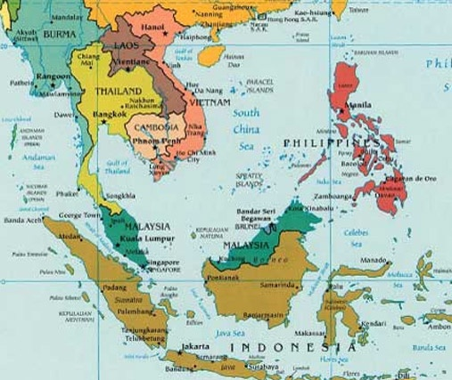
ASEAN DMM COUNTRY LEADERS gathering October 15-18, 2024 Jakarta, Indonesia Purposes: *Pray & listen to God *recalibrate dmm DNA *learn from each OTher *build asean DMM team powered by New Generations

Slide 2
What is New generations?
A DMM DNA organization.
Not a traditional mission org
Not a denomination
Not into branding
IF you want to work with us and are serious, we’ll commit to working with you to the point of 7 Generational movement. We exist to make you strong and fruitful.
Our focus 3D-DMM = healthy, multiplying disciples in multiplying churches in multiplying movements
We try to model everything for you to repeat, including MOU idea for you to do the same

Slide 3
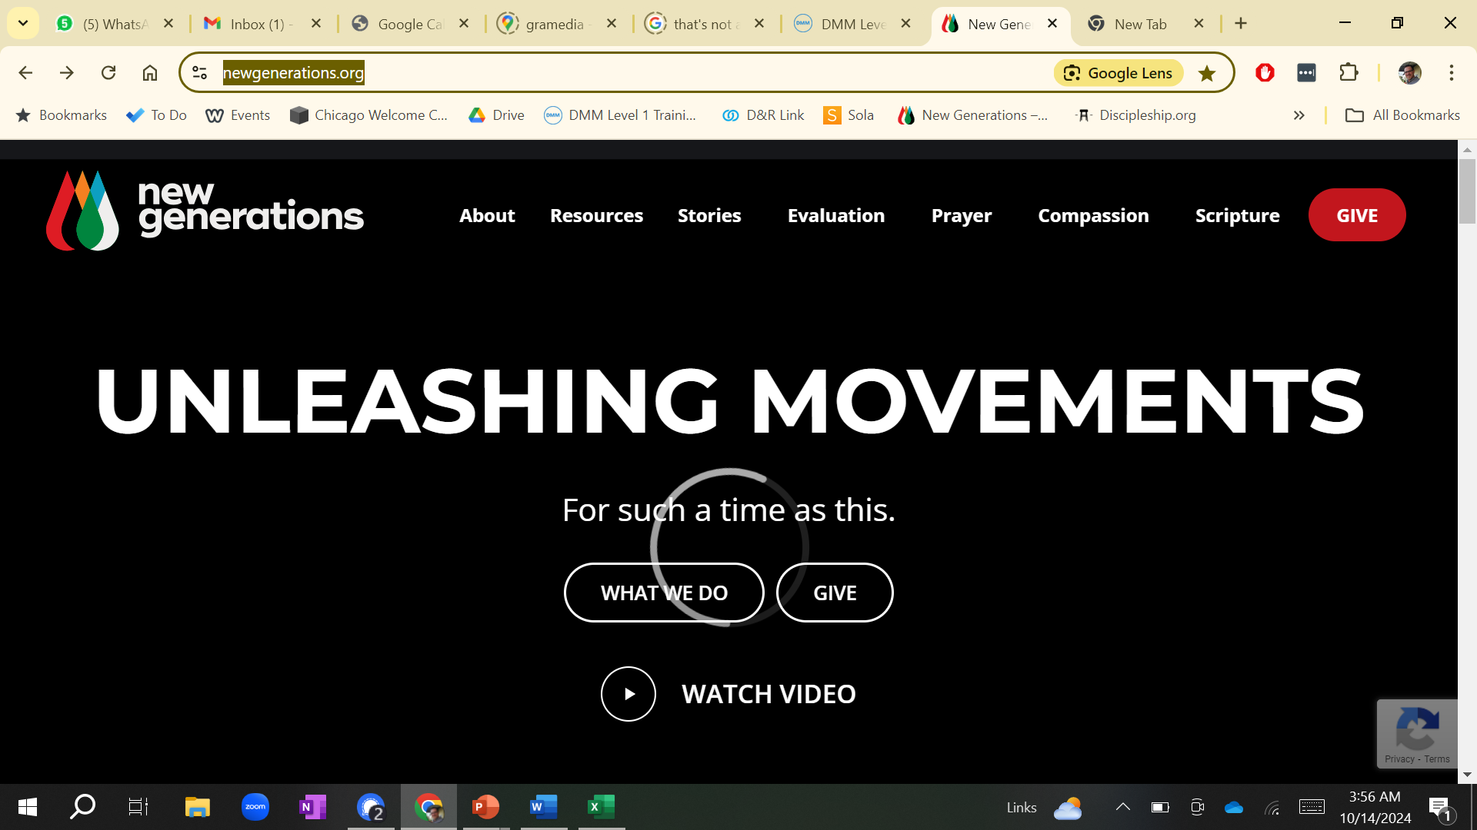
NG has little fruit of its own
NG’s fruit is through partnership
Here’s what’s happened:
233 movements of
140,000+ churches, and
2,7 Million new disciples
In 60 countries
Among 983 people groups
Since 2005

Slide 4
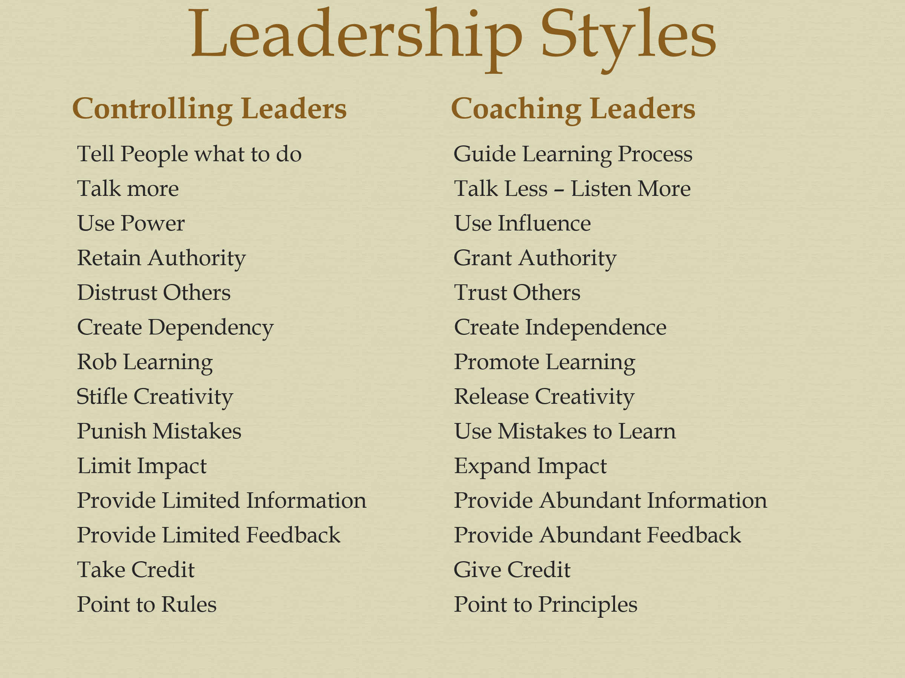
Such things only happen by changing our leadership style:

Slide 5
3D-DMM (pure DMM)

Slide 6

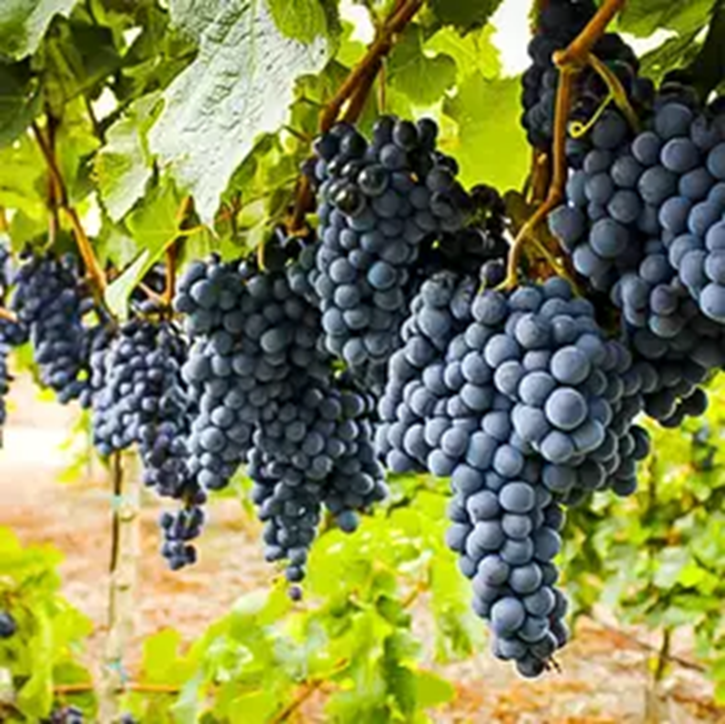
Yohn 15:1-17
What characterizes the fruit God wants?

Slide 7

3D = wide-deep-long
I’m bored with 1 and 2D!

Slide 8


So, what should be #1?
Quality! But how?
*Train & teach for maturity
*Train our disciples to be trainers
*Make leaders from the beginning
*Create an open and transparent culture
*Keep working on tactics; don’t stay stuck
© New Generations 2024

Slide 9
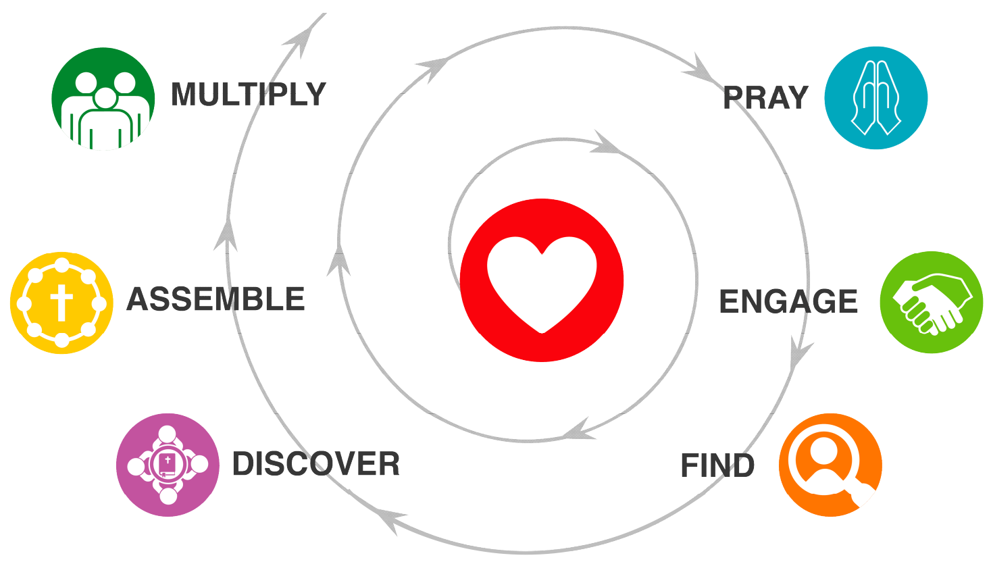
the dmm process
What is it a spiral?
What’s the difference between a method and a strategy?
What must be different in every place? What stays the same?
Has this become your way of life? In what ways yes / no?

Slide 10
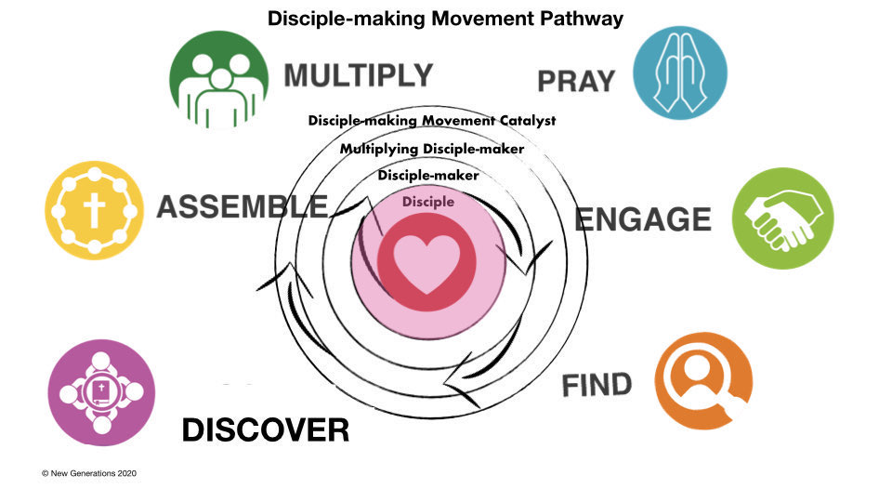
levels

Slide 11
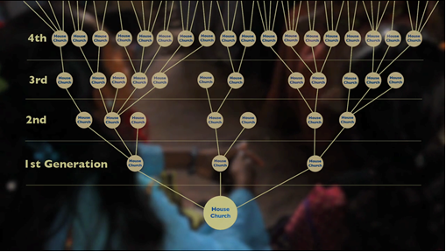
Dmm desired outcome

Slide 12
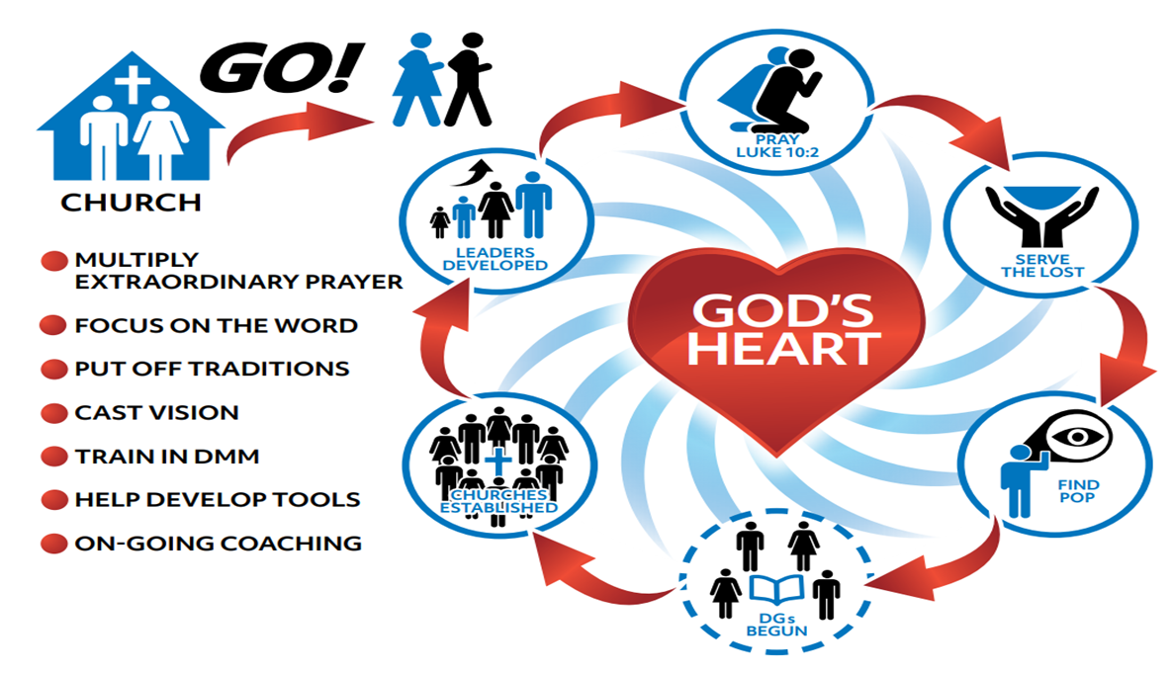
How do we relate to the regular churches? Avenue 1 avenue 2

Slide 13
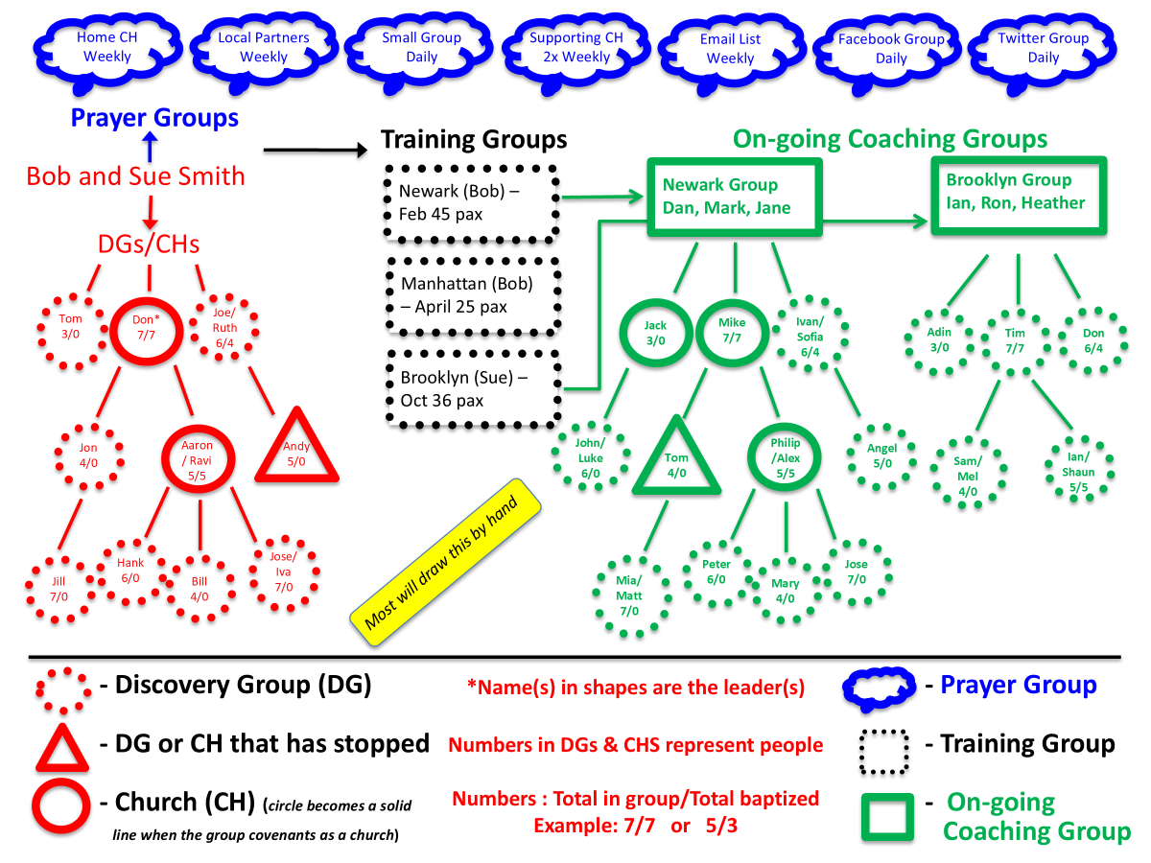
Tracking results

Slide 14
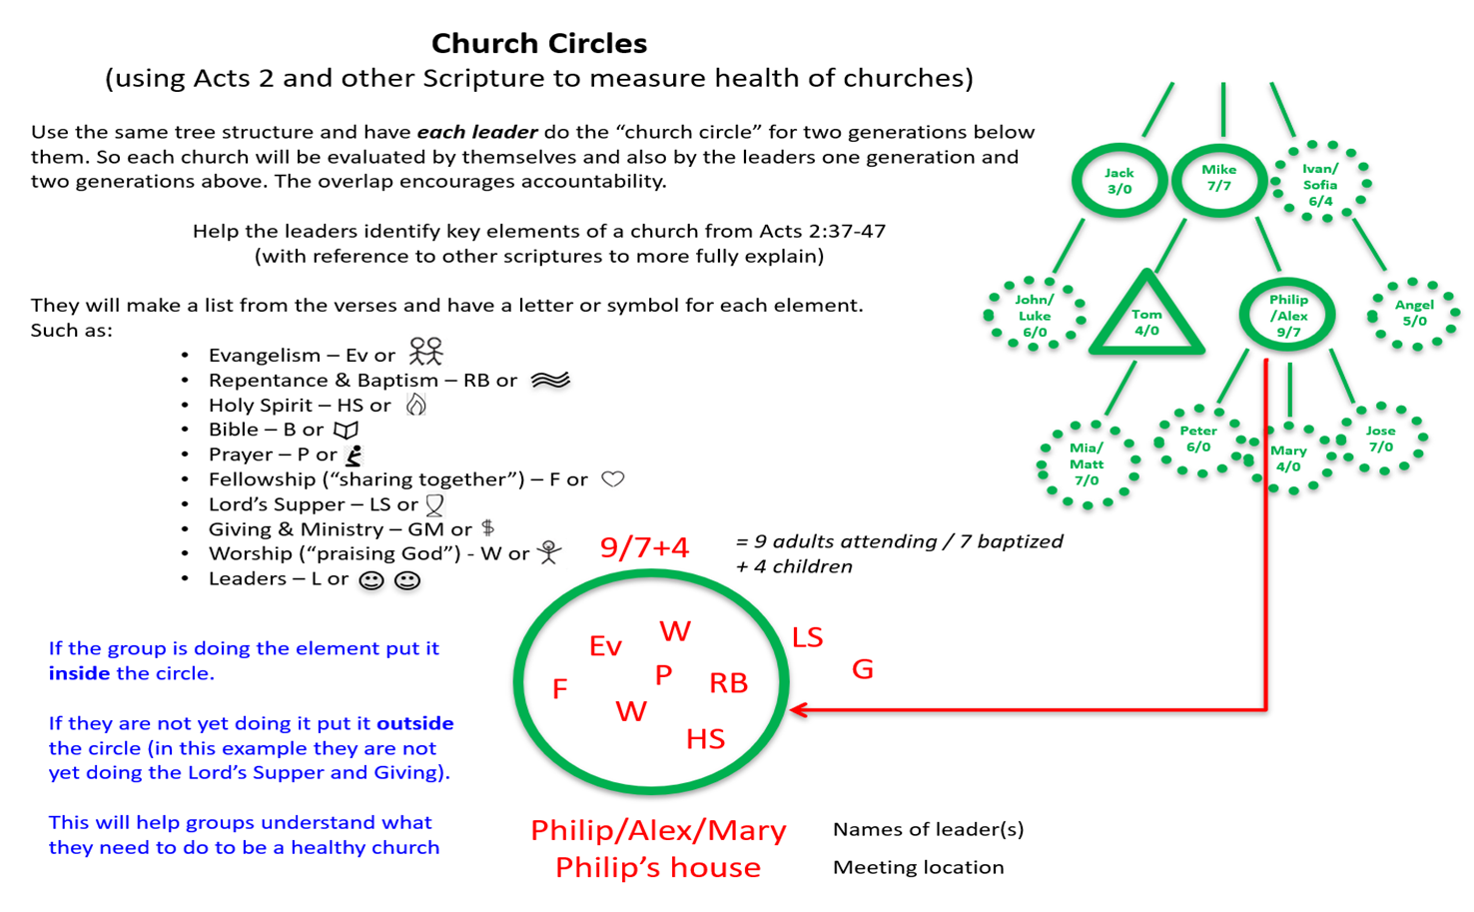
Inspecting the fruit

Slide 15
Peer coaching at every level
G4 Leaders
G3 Leaders
G2 Leaders
G1 Leaders
Team or Gen 0 House church

Slide 16
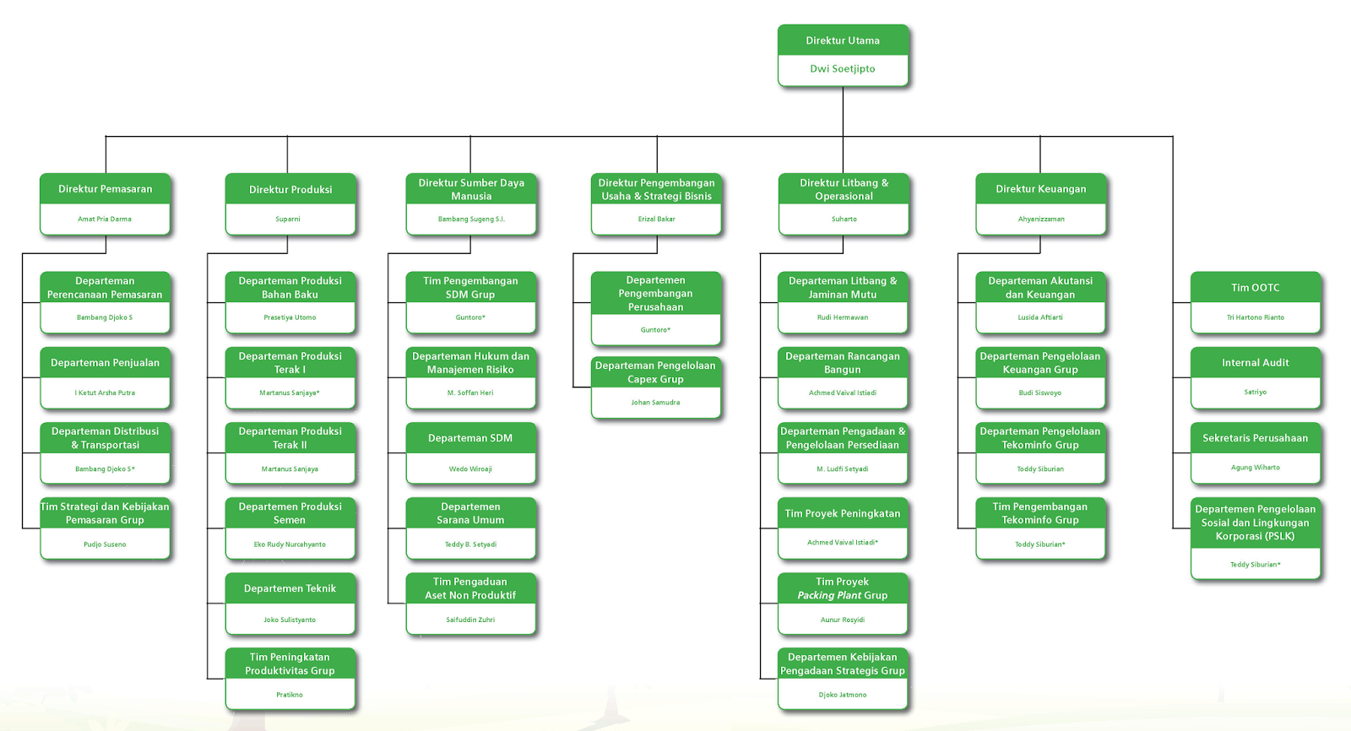
It will take structure
But not normal structure!

Slide 17
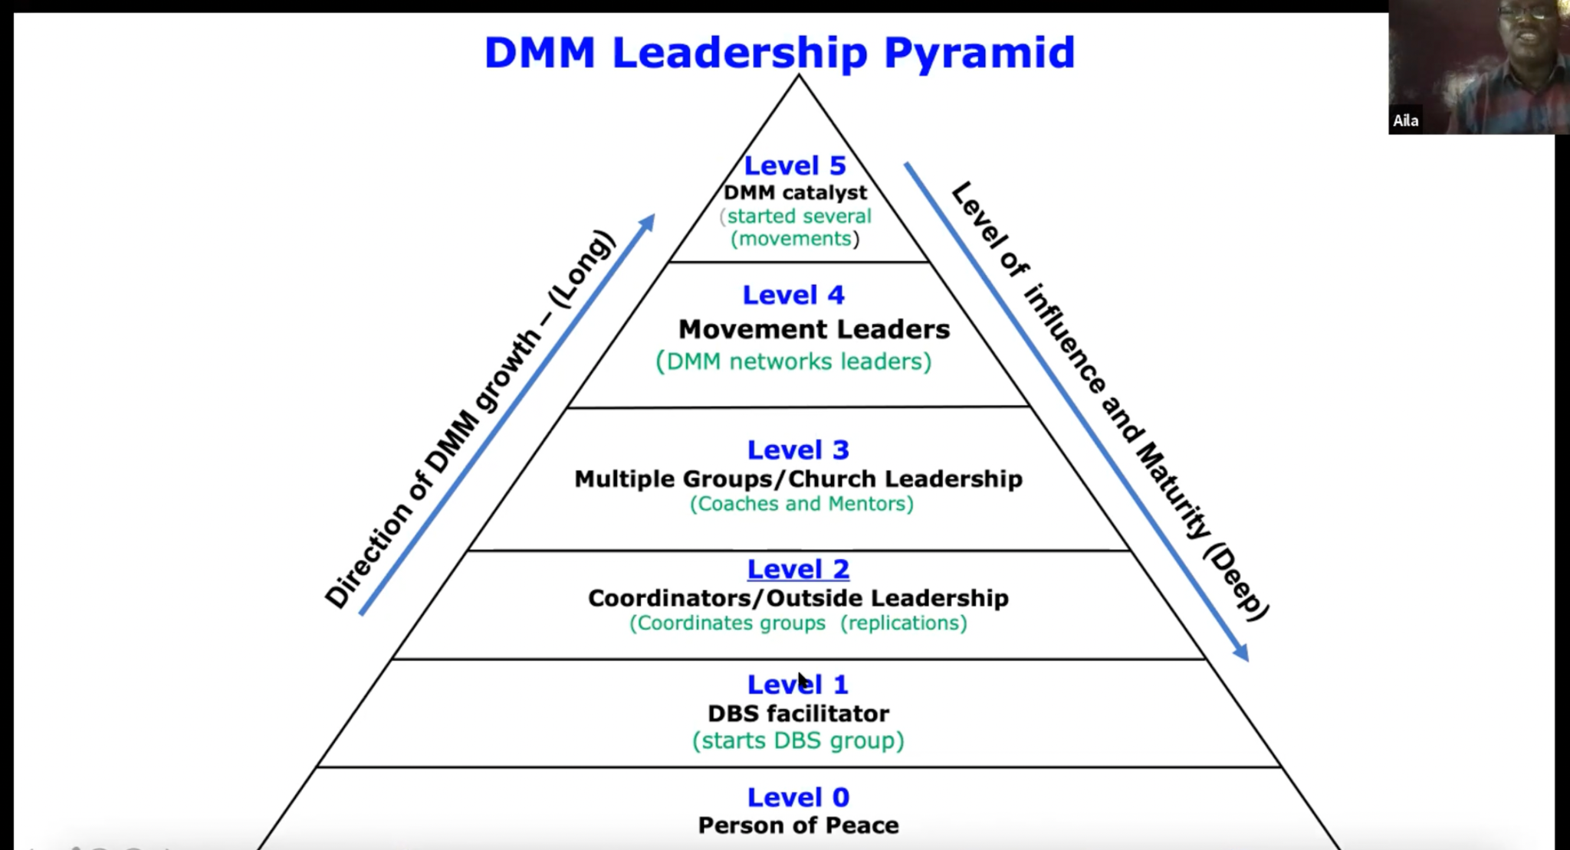
Dr. Aila tasse, Kenya
Notes:
Aila Tasse of Kenya

Slide 18
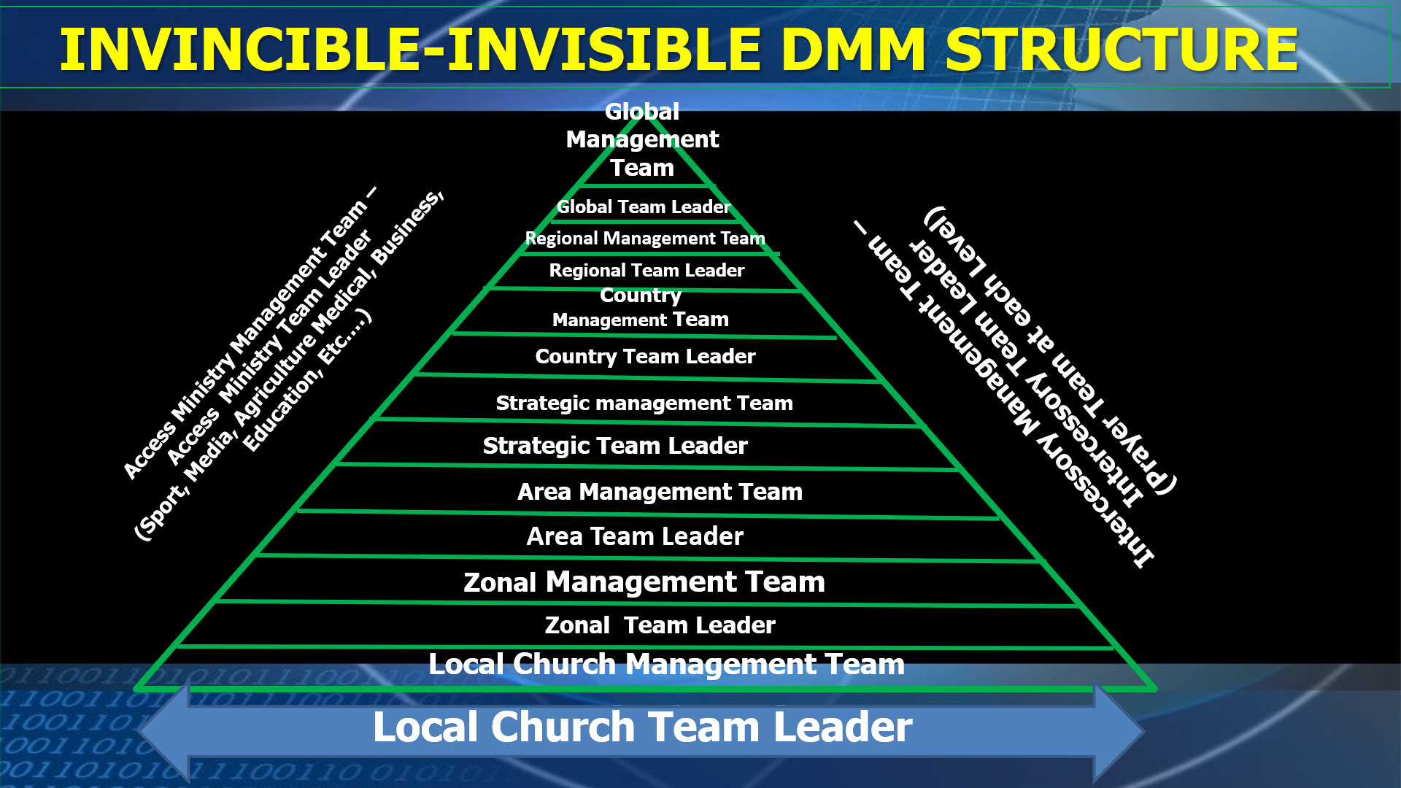
Rev. Shodankeh Johnson, Sierra Leone
Notes:
Shodankeh Johnson of Sierra Leone

Slide 19


Marzuki model

Slide 20


Slide 21

Don’t forget about prayer!

Slide 22
PRAYER STRUCTURE WITHIN ANGLOPHONE West Africa
Sends out national prayer request, organize national prayer retreats, conferences and programs.
Receive reports and collate them,
Note!!
At each level there are teams of intercessors with different team leaders.
National Prayer Movement.
Disciplining Every Disciple to Pray
(Through Couching and Mentoring)
Creating Prayer Movement at
Each Level
Every Country – Country Prayer Movement
Every District – District Prayer Movement
Every Area – Area Prayer Movement
Every Zone – Zonal Prayer Movement
Every Church Plant – Prayer Movement
Every Disciple An Intercessor

Slide 23
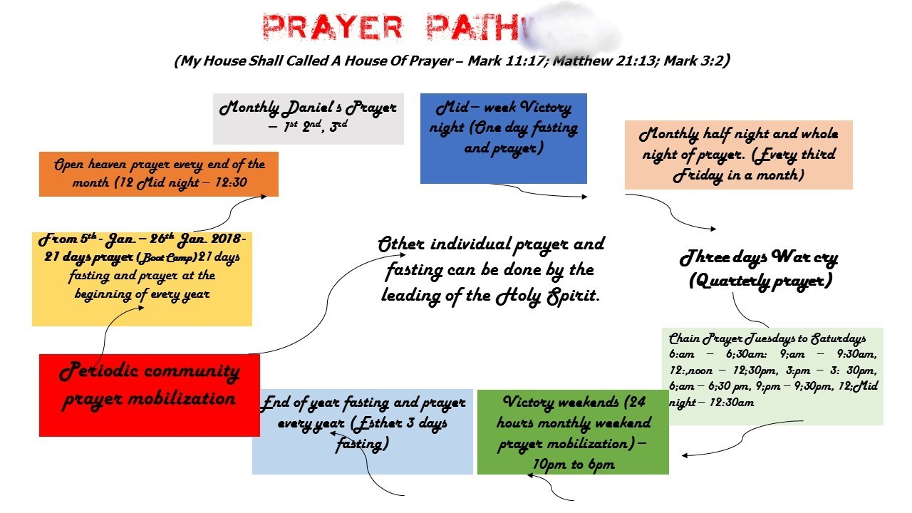
Calendar do’a

Slide 24


So is all this disconnected from the rest of the church?

Slide 25
L10 Indonesia
A network for DMM organizations
So we stay consistent and pure in DMM
So no one is left behind
To reach every segment of Indonesia

Slide 26
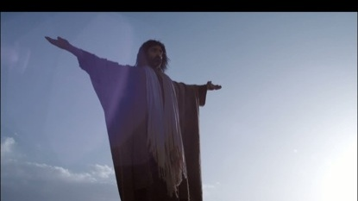

All praise to Jesus!

Slide 27
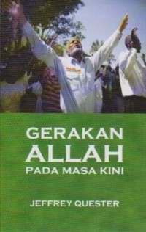
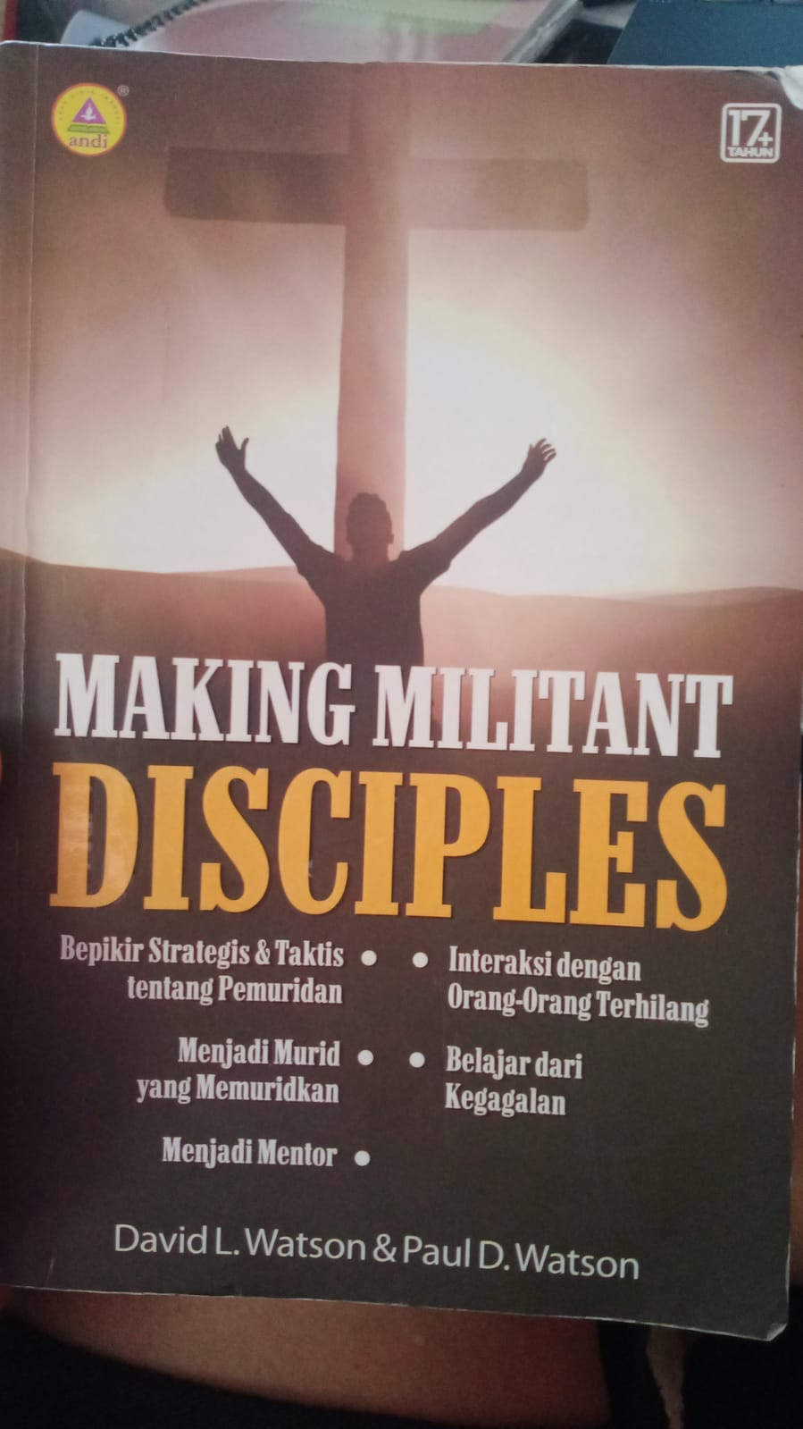

Referensi Buku Bahasa indonesia

Slide 28
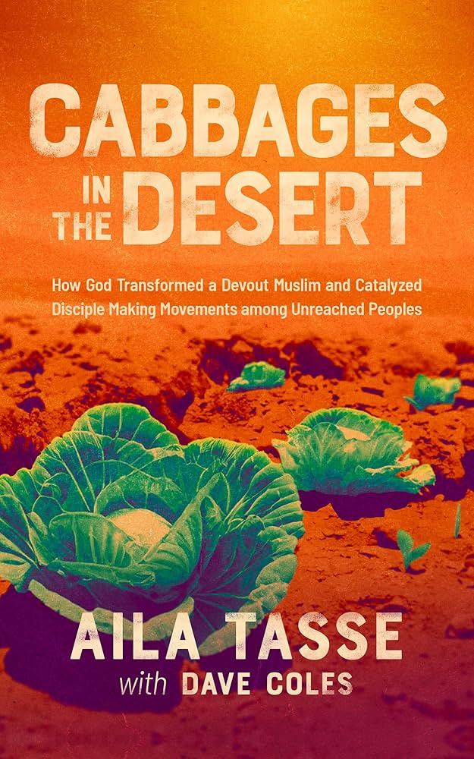
Baru terbit dalam bahasa inggeris

